Slide 1
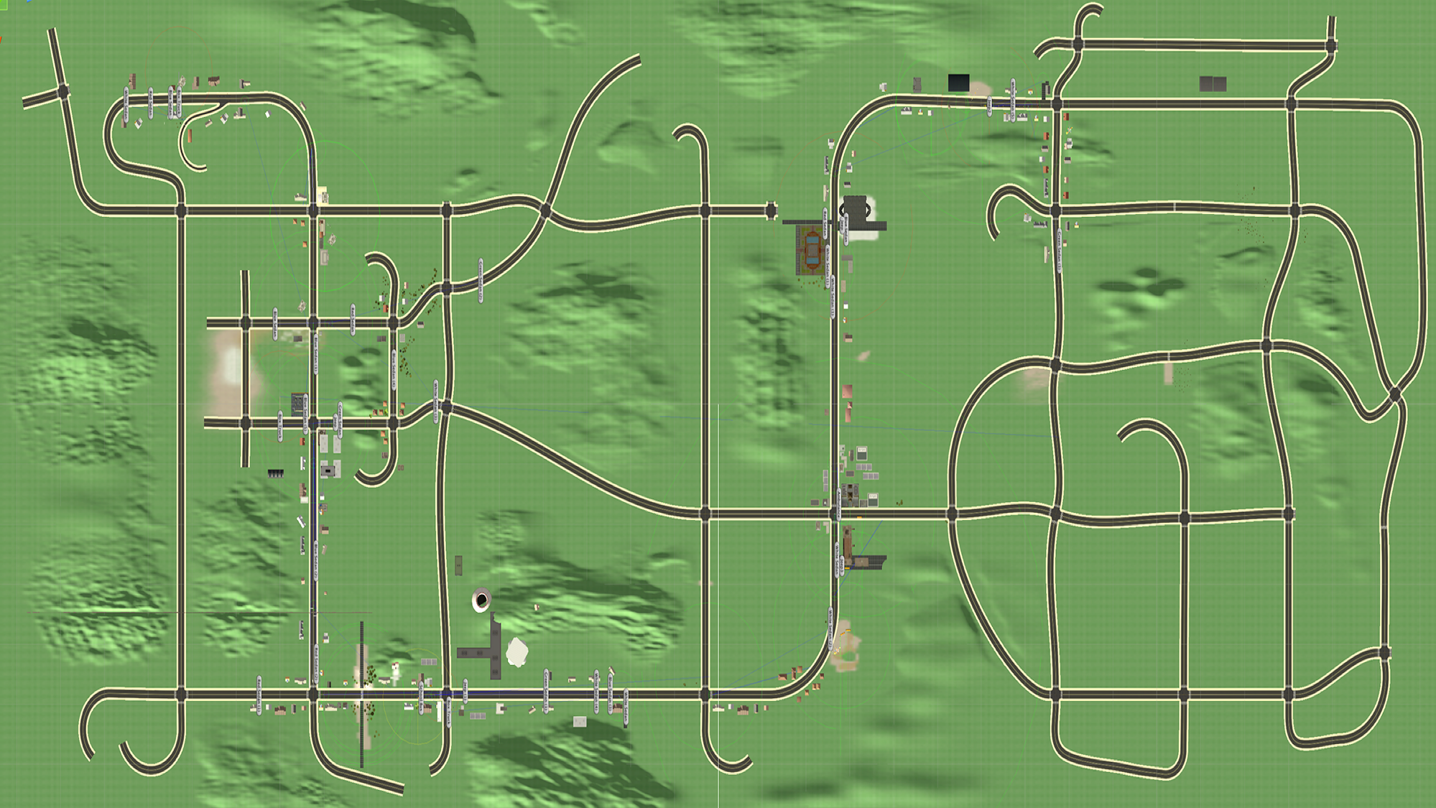
Construction_Zone
Intersection_1
25mph
35mph
Parking Garage_Curve
Finish (-446.60, 772.20)
Start (-464.55, -1216.65)
Intersection_2
Intersection_9
Intersection_3
35mph
Intersection_4
Ambulance
45mph
Intersection_8
School_Zone
Railroad_1
20mph
White_Truck_1
Crosswalk_1
45mph
35mph
35mph
Playground_Curve
Intersection_5
Intersection_6
Intersection_7
Pre_X_Walk
X_Walk
Notes:
Map 0: City 1 Ambulance Active

Slide 2
Construction_Zone
Intersection_1
25mph
35mph
Parking Garage_Curve
Finish (-446.60, 772.20)
Start (-464.55, -1216.65)
Intersection_2
Intersection_9
Intersection_3
35mph
Intersection_4
45mph
Intersection_8
School_Zone
Railroad_1
20mph
White_Truck_1
Crosswalk_1
45mph
35mph
35mph
Playground_Curve
Intersection_5
Intersection_6
Intersection_7
Pre_X_Walk
X_Walk
Notes:
Map 0: City 2 Ambulance Inactive

Slide 3
Construction_Zone
Intersection_1
25mph
35mph
Parking Garage_Curve
Finish (-446.60, 772.20)
Start (-464.55, -1216.65)
Intersection_2
Intersection_11
Intersection_3
Intersection_4
35mph
Intersection_6
Intersection_5
Ambulance
45mph
Intersection_10
School_Bus
School_Zone
Railroad_1
20mph
Crosswalk_1
White_Truck_1
45mph
35mph
35mph
Playground_Curve
Intersection_7
Intersection_8
Intersection_9
Pre_X_Walk
X_Walk
Notes:
Map 0: City 5 Ambulance Active

Slide 4
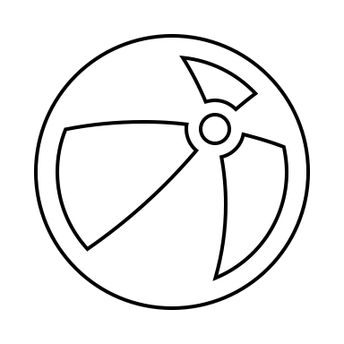

Traffic Merge
Construction Zone
35mph
Baseline Curve
Finish
25mph
Start
Jaywalker
35mph
Baseline Straightaway
Ambulance
45mph
Car-Following
School Bus
20mph
Railroad Crossing (Inactive)
School Zone
35mph
Truck-Following
35mph
Playground Curve
Crosswalk
45mph
Notes:
Map 0: City 5 (Edited for Presentations)

Slide 5
Construction_Zone
Intersection_1
25mph
35mph
Parking Garage_Curve
Finish (-446.60, 772.20)
Start (-464.55, -1216.65)
Intersection_2
Intersection_11
Intersection_3
Intersection_4
35mph
Intersection_6
Intersection_5
45mph
Intersection_10
School_Bus
School_Zone
Railroad_1
20mph
Crosswalk_1
White_Truck_1
45mph
35mph
35mph
Playground_Curve
Intersection_7
Intersection_8
Intersection_9
Pre_X_Walk
X_Walk
Notes:
Map 0: City 6 Ambulance Inactive

Slide 6
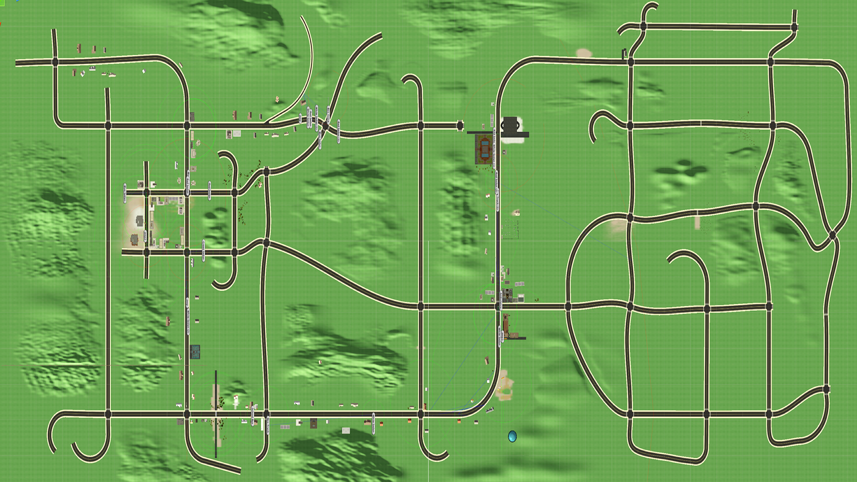
Start (-420.94, -476.27)
Intersection_2
Finish (-342.40, 265.80)
35mph
Intersection_1
Intersection_4
Intersection_3
45mph
25mph
Intersection_6
Intersection_5
35mph
35mph
Ambulance
Intersection_10
School_Zone
Railroad_1
20mph
White_Truck_1
Crosswalk_1
45mph
Playground_Curve
Intersection_7
Intersection_8
Intersection_9
Pre_X_Walk
X_Walk
Notes:
Map 1: City 3

Slide 7
Start (-420.94, -476.27)
Intersection_2
Finish (-342.40, 265.80)
35mph
Intersection_1
Intersection_4
Intersection_3
45mph
25mph
Intersection_6
Intersection_5
35mph
35mph
Intersection_10
School_Zone
Railroad_1
20mph
White_Truck_1
Crosswalk_1
45mph
Playground_Curve
Intersection_7
Intersection_8
Intersection_9
Pre_X_Walk
X_Walk
Notes:
Map 1: City 8

Slide 8
Start (-420.94, -476.27)
Intersection_2
Finish (-342.40, 265.80)
35mph
Intersection_1
Intersection_4
Intersection_3
45mph
25mph
Intersection_6
Intersection_5
35mph
35mph
Ambulance
Intersection_10
School_Bus
School_Zone
Railroad_1
20mph
White_Truck_1
Crosswalk_1
45mph
Playground_Curve
Intersection_7
Intersection_8
Intersection_9
Pre_X_Walk
X_Walk
Notes:
Map 1: City 9

Slide 9
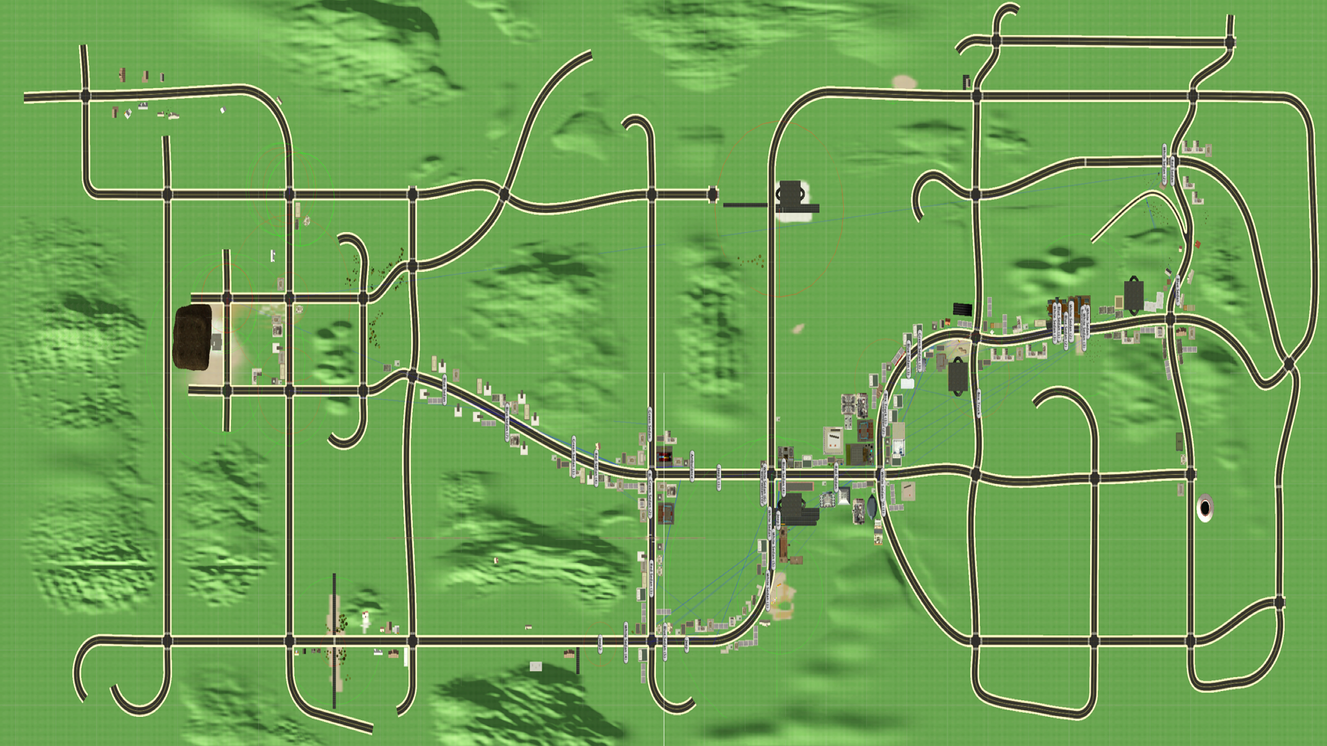

Intersection_1
Start (-315.39, 1173.16)
Finish (31, -506)
Crosswalk_1
35mph
Intersection_3
35mph
Intersection_2
Ambulance
Intersection_5
X_Walk
Pre_X_Walk
White_Sedan_1
Intersection_7
Intersection_4
Railroad_1
20mph
Jaywalker
Intersection_6
Playground_Curve
Notes:
Map 2 : City 4

Slide 10
Intersection_1
Start (-315.39, 1173.16)
Finish (31, -506)
Crosswalk_1
35mph
Intersection_3
35mph
Intersection_2
Intersection_5
X_Walk
Pre_X_Walk
White_Sedan_1
Intersection_7
Intersection_4
Railroad_1
20mph
Jaywalker
Intersection_6
Playground_Curve
Notes:
Map 2 : City 7

Slide 11
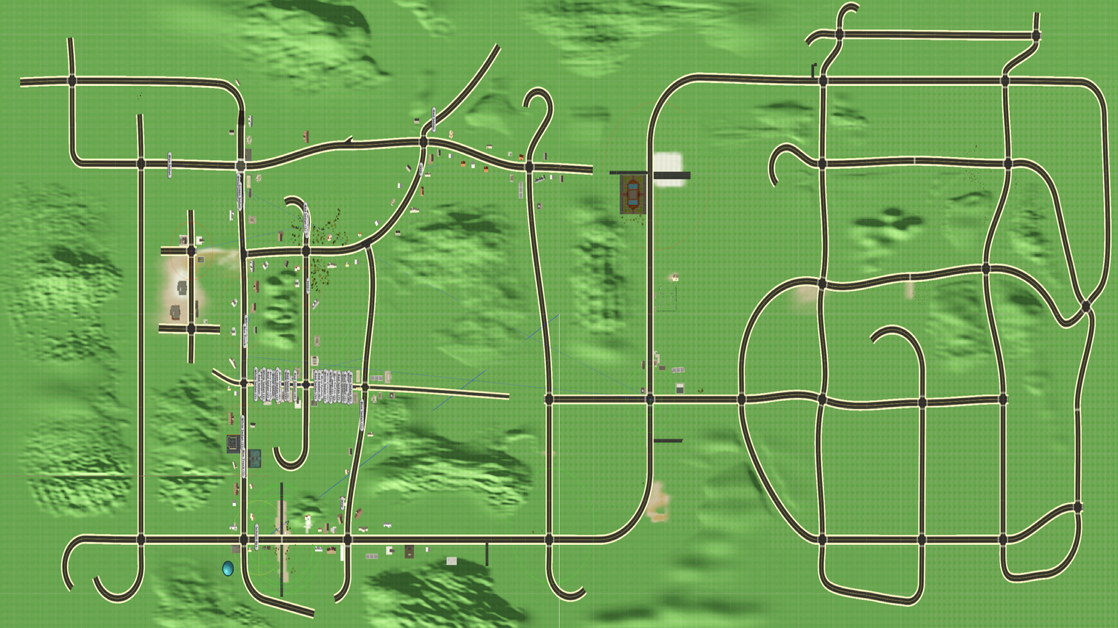
Finish (-319.20, -1094.90)
Intersection_2
Intersection_1
35mph
Start (-318.11, 4.40)
Intersection_11
Intersection_4
Intersection_3
Intersection_10
Car_Following_Task_1
Intersection_5
Intersection_6
Intersection_9
Car_Following_Task_2
Railroad_1
Crosswalk_1
Intersection_8
Intersection_7
School_Bus
X_Walk
Pre_X_Walk
Notes:
Map 3 : City 10

